Slide 1

Town of Middleton Property Tax Classification Hearing Presentation and Information Fiscal Year 2026
Tuesday November 18, 2025
Prepared by the Board of Assessors
Meredith Stone M.A.A. - Chair
Toula Guarino M.A.A. -Clerk
Deborah J. Carbone M.A.A.
Bradford W. Swanson M.A.A. Chief Assessor
Kate B. Davies - Deputy Assessor
Jodi Fish & Donna Peary- P/T Assessing Administrative Assistant/Data Collector

Slide 2

Role of the Select Board
This information is intended to provide the Select Board with the necessary information to conduct a Public Hearing on the tax classification options available under the Massachusetts General Laws.
During the Commonwealth mandated Tax Classification Hearing, the Select Board must vote on the following in order to establish a tax rate:
Open Space Discount
Residential Exemption
Small Commercial Exemption
Classification (shifting of the tax rate)

Slide 3
Relevant information

Slide 4
FY 2026 Valuation Statistics
The total taxable valuation of the town has increased 2.3 % to $3,361,204,326.
FY 2026 average single family assessed value is $970,547. A .78% increase of from last year’s average of $962,948.
FY 2026 average assessed condominium value is $ $639,881. An increase of 13% from last year’s average of $600,9481.
FY 2026 commercial total value up 2.5%.
FY 2026 industrial total value up 3.8%.
FY 2026 personal property is up 4%
FY 2026 public utilities up 2.0%.
See full packet for further statistics

Slide 5
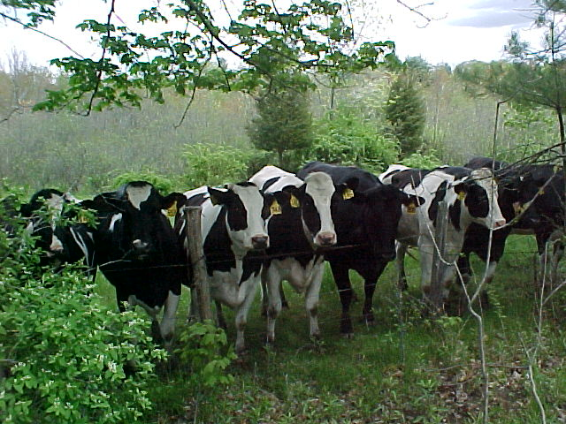
Open Space Discount
Open space is land maintained in an open or natural condition which contributes significantly to the benefit and enjoyment of the public and which is not:
Subject to a permanent conservation restriction;
Held for the production of income;
Taxable under the provisions of:
Chapter 61 (forestry)
Chapter 61A (agricultural land)
Chapter 61B (recreation land)

Slide 6
The Select Board may discount up to 25% of the Open Space share of taxes.
Of the 351 municipalities in Massachusetts, 16 classify property as Open Space (3 in Essex County):
Ashland, Berlin, Beverly, Dennis, Erving, Falmouth, Leominster, Mashpee, Nantucket, Newburyport, Norfolk, Rowley, South Hadley, Sturbridge, Whately, and Winthrop.
The Board of Assessors has determined that Middleton does not have eligible Open Space land. Most large parcels are in a Chapter program.

Slide 7
Residential Exemption
The of Select Board may adopt an exemption of up to 35% to shift the Residential Class tax burden from lower assessed properties that are the principal residence of a taxpayer to higher assessed properties and properties that are not the principal residence of a taxpayer.
The following twenty municipalities allow a residential exemption. Note that most of these communities are large cities and/or oceanfront communities with large rental or second home inventory.
Barnstable, Boston, Brookline, Cambridge, Chelsea, Concord, Eastham, Everett, Malden, Mashpee, Nantucket, Oak Bluffs, Provincetown, Somerville, Tisbury, Truro, Waltham, Watertown, West Tisbury, and Wellfleet.
The next page illustrates an example:

Slide 8
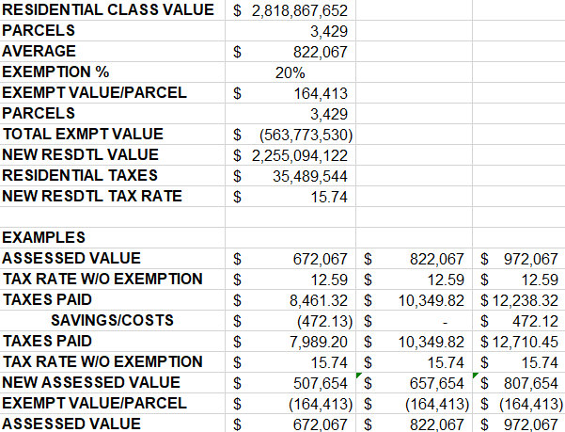

Slide 9
SMALL COMMERCIAL EXEMPTION:
The Select Board may adopt an exemption of up to 10% to shift the Commercial Class tax burden from eligible parcels to ineligible parcels. Eligible parcels must have:
Be Class Three, Commercial, property.
Be occupied solely by businesses with an average annual employment of 10 or under at all locations during the prior calendar year. (Assessors may determine annual employment for a sole proprietorship or partnership. For all other businesses, they must rely solely on the determination of the Director of Labor and Workplace Development.)
Have an assessed valuation of $1,000,000 or less before the application of the exemption.

Slide 10
Small commercial exemption
The following communities have adopted the exemption:
Auburn, Avon, Bellingham, Berlin, Braintree, Chelmsford, Dartmouth, Erving, New Ashford, North Attleborough, Seekonk, Swampscott, Westford and Wrentham.
The mechanics of the Small Commercial Exemption are similar
to the Residential Exemption.
An annual application process is required confirming payroll information

Slide 11
CLASSIFICATION:
“An amendment to the Massachusetts Constitution endorsed by the electorate in 1978 resulted in the Classification Act. This Act requires municipalities to classify real property into one of four classes, according to use: residential, open space, commercial and industrial.
Cities and towns that are certified as assessing property at full and fair cash value may elect to shift the tax burden among the major property classes within certain limits established by law. The adoption of different rates does not change the total property tax levy; rather it determines the share of the total levy to be borne by each class.” (Tax Classification BLA Publication)
The share of the levy raised by the commercial and industrial classes and personal property may be increased 50% as long as the residential and open space classes raise at least 65% of what they would have raised without the shift.

Slide 12
FY 2025 of 351 municipalities in the Commonwealth, 113 (32%) shift the tax rate.
Of the 113, 67 (59%) shift over 1.50 to CIP (Commercial, Industrial, Personal Property)
In Essex County, the following communities shift their rate:
*Please note that most of these communities are larger cities or towns and only three shift under 1.50.

Slide 13
The "Minimum Residential Factor" or MRF established by the Commissioner of Revenue is used to make certain that the shift of the tax burden complies with the Classification Act. If the minimum residential factor would be less than .650000, the community cannot make the maximum shift and must use a CIP factor less than 1.50.
In Middleton, The Select Board may shift the Town’s tax burden from the Residential Class to the Commercial, Industrial and Personal Property Classes as long as the shift does not exceed the Minimum Residential Factor (MRF). Middleton’s Minimum Residential Factor is 90.3759%.
The following pages contain information on the development of the Minimum Residential Factor (MRF) and on the impact of any shift of the tax rate:

Slide 14
Tax Rate Shift Implications on average class values

Slide 15
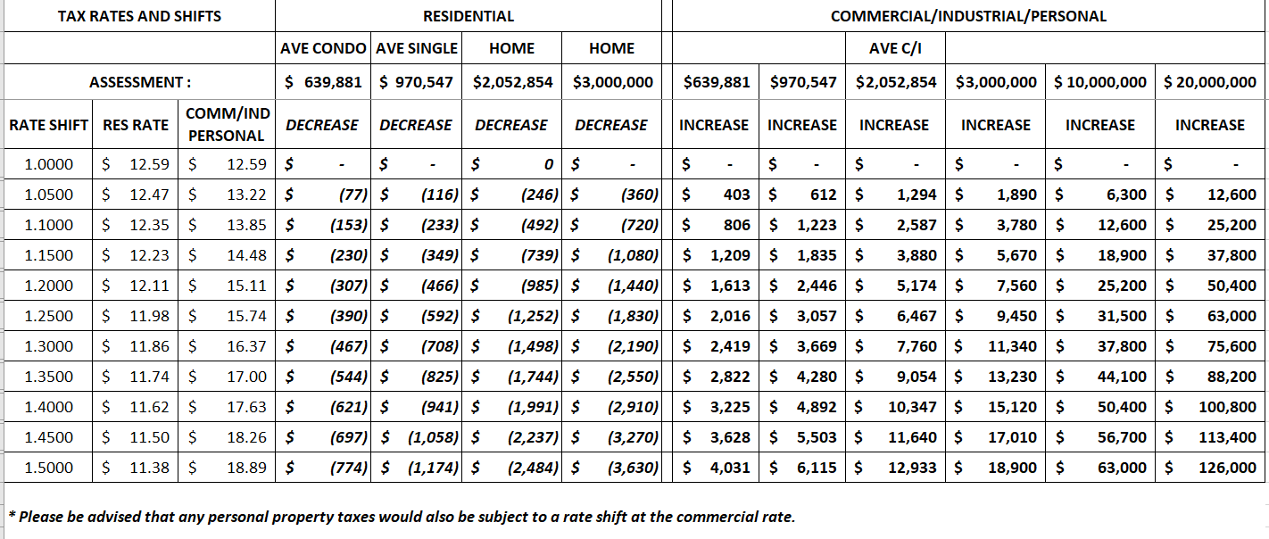
Tax rate shift implication examples

Slide 16

Options to vote:
Vote to discount Open Space?
Vote on Residential Exemption?
Vote on Small Commercial Exemption?
Vote on Classification: Single or split rate?

Slide 17
Thank you!
I would like to thank my Board and staff for their efforts during the year and for the inter-cooperation of other town departments.

